Slide 1
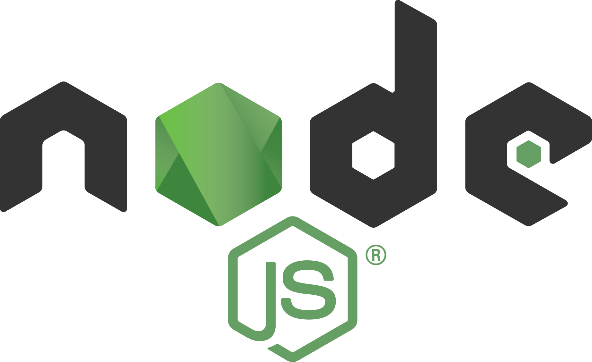

Slide 2
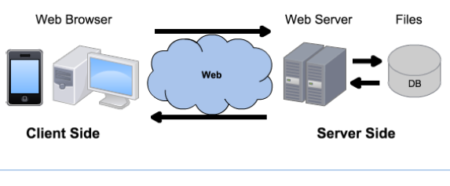
Linux
Windows
MacOS
Android
Linux
Windows Server
Apache
Tomcat
IIS
NodeJS
MySQL
Oracle
SQL Server
MongoDB
Chrome
Firefox
Safari
HTTP
HTTPS
HTML
CSS
JavaScript
PHP
Java
ASP
JavaScript
Bootstrap
SQL
JSON
jQuery
Notepad++
Eclipse
Visual Studio

Slide 3
Node.js
Node.js is an open-source runtime server environment.
Written in C++, Google Chrome’s V8 JS engine compiles JavaScript source code to native machine code in runtime, instead of interpreting it ahead of time.
It allows you to run JavaScript on the server.
It is free and runs on various platforms (Windows, Linux, Unix, Mac OS X, etc.)
Node.js represents a "JavaScript everywhere" paradigm
unifying web application development around a single programming language, rather than different languages for server-side and client-side scripts.
Notes:
Node.js uses libuv to handle asynchronous events, an abstraction layer for network and file system functionality on both Windows and POSIX-based systems such as Linux, MacOS, and Unix.

Slide 4
Why Node.js?
Node.js uses asynchronous I/O programming!
It runs single-threaded, non-blocking, asynchronous programming, which is very memory efficient - no thread context switching.
Node.js can generate dynamic page content
it can create, open, read, write, delete, and close files on the server;
it can collect form data;
it can create, read, update, delete data in your database
Node.js is great for event-driven (callback) architectures, facilitating scalability and real-time web applications (like real–time communications, browser games…).

Slide 5
Apache/PHP versus Node.js
How PHP handles a file request:
Sends the task to the computer's file system.
Waits while the file system opens and reads the file.
Returns the content to the client.
Ready to handle the next request.
How Node.js handles a file request:
Sends the task to the computer's file system.
Ready to handle the next request.
When the file system has opened and read the file, the server returns the content to the client.
Observer pattern: subject maintains a list of observers and notifies them of state changes by calling a method
Node.js eliminates the waiting, and simply continues with the next request.

Slide 6
Why maybe not Node.js?
Not multi-threaded (yet)
But allows multiple cores, child processes communicating with sockets – DIY load balancing
CPU intensive operations will perform poorly
Only I/O is asynchronous, it has no thread switching
Loss of data
In case of error (with single thread), global data may be lost
Maturity of documentation, support
Frequent changes, not always backward compatible
It takes experience to judge the packages in NPM

Slide 7
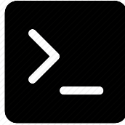
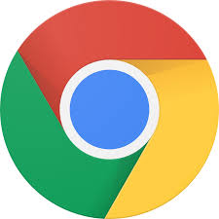
Getting Started
Download and install Node.js from: https://nodejs.org
Node.js files contain tasks that will be executed on certain events, like someone trying to access a port on the server
Node.js files have extension ".js"
Node.js files must be initiated on the server before having any effect
cmd
node hello.js
browser
http://localhost:8080/
terminate process
ctrl + c

Slide 8

hello.js
var http = require('http'); // include module for the http server var url = require('url'); // include module to split the query string
http.createServer(function (req, res) {
res.writeHead(200, {'Content-Type': 'text/html'}); var q = url.parse(req.url, true).query; // returns an object
res.end('Hello World! The month is: ' + q.month); }).listen(8080);
/* req is an http.IncomingMessage object, which contains the url property (after the domain name) */
HTTP GET method

Slide 9
Modules
Modules are the same as JavaScript libraries: a set of functions you want to include in your web application.
You can create your own modules, and easily include them:
On a file mymodule.js write:
exports.myDateTime = function () { return Date(); };
Use it in the main server file with:
var dt = require('./mymodule');
dt.myDateTime();

Slide 10
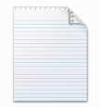
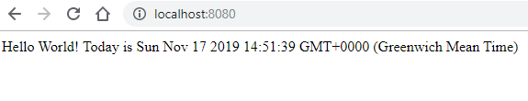
Example
today.js // server
mymodule.js
var http = require('http');
var dt = require('./mymodule');
http.createServer(function (req, res) {
res.writeHead(200, {'Content-Type': 'text/html'});
res.end('Hello World! Today is ' + dt.myDateTime());
}).listen(8080);
exports.myDateTime = function () {
return Date();
};
node today.js
ctrl + c

Slide 11
URL module
var url = require('url'); var adr = 'http://localhost:8080/default.htm?year=2017&month=february'; var q = url.parse(adr, true); console.log(q.host); //returns 'localhost:8080' console.log(q.pathname); //returns '/default.htm' console.log(q.search); //returns '?year=2017&month=february' var qdata = q.query; //returns an object: { year: 2017, month: 'february' } console.log(qdata.month); //returns 'february'

Slide 12
Serving Files
var http = require('http'); var url = require('url'); var fs = require('fs'); http.createServer(function (req, res) { var q = url.parse(req.url, true); var filename = "." + q.pathname; fs.readFile(filename, function(err, data) { if (err) { res.writeHead(404, {'Content-Type': 'text/html'}); return res.end("404 Not Found"); } res.writeHead(200, {'Content-Type': 'text/html'}); res.write(data); return res.end(); }); // you can use 'return' to ensure you stop after the (first) callback }).listen(8080);
http://localhost:8080/index.html

Slide 13
Packages
NPM is a pre-installed package manager for Node.js packages.
www.npmjs.com hosts thousands of free packages.
A package in Node.js contains all the files you need for a module.
On the command line, tell NPM to download any package:
npm install upper-case
NPM uses the folder "node_modules" to place the packages, e.g.
C:\nodejs\node_modules\upper-case
Include the "upper-case" package in the same way you include any other module:
var uc = require('upper-case');

Slide 14
Some Node Packages
File Upload
https://www.w3schools.com/nodejs/nodejs_uploadfiles.asp
Sending emails
https://www.w3schools.com/nodejs/nodejs_email.asp
Express → later, to build REST APIs
Database Access

Slide 15

MySQL
MySQL is the most popular open-source relational database.
You can download a free MySQL database at: https://www.mysql.com/products/community/
Include the “MySQL Workbench”, a GUI to manage your DB.

Slide 16
Node.js MySQL
npm install mysql
var mysql = require('mysql'); var con = mysql.createConnection({ host: "localhost", user: "yourusername", password: "yourpassword", database: "mydb" }); con.connect(function(err) { if (err) throw err; con.query("SELECT name, address FROM users", function (err, result, fields) { // fields is an array with information about each field as an object if (err) throw err; console.log(result[2].address); }); });

Slide 17
Node.js MySQL SELECT
When query values are provided by the user, you should escape special characters to prevent SQL injections:
var sql = 'SELECT * FROM users WHERE address = ' + mysql.escape(adr);
or
var sql = 'SELECT * FROM users WHERE name = ? OR address = ?';
con.query(sql, [name, adr], function (err, result){
// TODO
});
Find names starting with S:
con.query("SELECT * FROM users WHERE name LIKE 'S%'", function (err, result) { // TODO
});

Slide 18
Node.js MySQL INSERT
For tables with an auto increment id field, you can get the id of the row you just inserted by asking the result object.
Note: only one row can have been inserted.
con.connect(function(err) { if (err) throw err; var sql = "INSERT INTO users (name, address) VALUES ('Michelle', 'Blue Village 1')"; con.query(sql, function (err, result) { if (err) throw err; console.log("1 record inserted, ID: " + result.insertId); }); });

Slide 19
Node.js MySQL UPDATE
con.connect(function(err) { if (err) throw err; var sql = "UPDATE users SET address = 'Canyon 123’ WHERE address = 'Valley 345'"; con.query(sql, function (err, result) { if (err) throw err; console.log(result.affectedRows + " record(s) updated");
// e.g. 2 record(s) updated }); });

Slide 20
Node.js MySQL DELETE
con.connect(function(err) { if (err) throw err; var sql = "DELETE FROM users WHERE address = 'Mountain 21'"; con.query(sql, function (err, result) { if (err) throw err; console.log("deleted: " + result.affectedRows + " rows.");
// e.g. deleted 3 rows }); });

Slide 21


Slide 22
MVC
The Model-View-Controller (MVC) pattern, originally formulated in the late 1970s, is a software architecture design pattern built on the basis of keeping the presentation of data separate from the methods that interact with the data
An MVC system should allow a front-end developer and a back-end developer to work on the same system in parallel
MVC was originally designed for desktop GUIs, but it has been adapted and adopted by web developers
The pattern encourages the development of modular systems, allowing developers to quickly update, add, or even remove functionality.

Slide 23
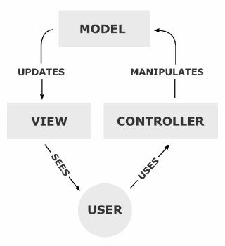
Server-Side MVC
One-way data flow system!

Slide 24
Model
In server-side MVC, the Model includes persistent data and variables for business logic. It must allow access for the data to be viewed, collected and written to.
The Model is technically “blind” – it has no knowledge of what happens to the data when it is passed to the View.
Its sole purpose is to process data into its permanent storage or seek and prepare data to be passed along.
The Model asks no questions and accepts all requests.
Notes:
e.g. logic such as authenticated username

Slide 25
View
The View is where data, requested from the Model, is viewed and its final output is determined. Traditionally, it is the part of the system where the HTML is generated and displayed.
The View also ignites reactions from the user, who then goes on to interact with the Controller. For example, a button generated by a View, which a user clicks and triggers an action in the Controller.
Many mistake the View as having no connection whatsoever to the Model and that all of the data displayed by the View is passed from the Controller.
In reality, there is no direct relationship between the View and the Controller without the Model or the User between them.
Notes:
e.g. submit form data, perform server-side form validation

Slide 26
Controller
The Controller handles data that the user inputs or submits, and updates the Model accordingly. It servers the user interactions. Each Controller function is triggered by the user’s interaction with the View.
The Controller collects information, passes it on to the Model to be organized for storage, and does not contain any logic other than that needed to process the input.
A common mistake is assigning to the Controller responsibilities that the View should have, like the crunching and processing of data from the Model to the View.
Notes:
Note: button to filter (javascript) uses client-side MVC (two-way data binding)

Slide 27
DRY principle
“Don’t Repeat Yourself”: every piece of knowledge must have a single, authoritative representation within a system.
The aim is to maximize system dynamism and optimization. If you need to write the same piece of code in many places, create a separate method and use it wherever required.
This introduces the possibility of caching and improving the overall run time.
Changing one element of the system does not change unrelated elements, making DRY an important principle when developing with MVC patterns.
It promotes code reuse and parallel development.

Slide 28
Questions?

